Slide 1
IMDB
Project 6

Slide 2
Overview
Objective
Data Set
Cleaning/Set Up Data
Model
Result

Slide 3
Objective
Which words in a review will lead to a high IMDB rating

Slide 4
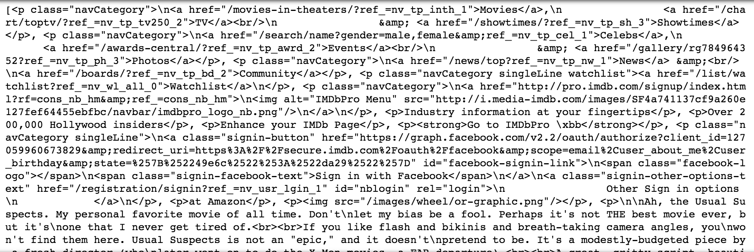
Data Set
IMDB Top 25 movie reviews
Retrieve a string of words and determined which words were important

Slide 5
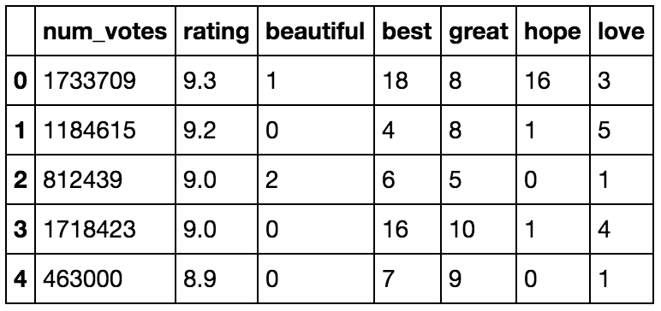
Cleaning/Set Up Data
Words counted per movie
'best', 'hope', 'love', 'beautiful', 'great’
Combine datasets together
Remove columns

Slide 6
Models
Decision Tree
Variables Used for Prediction
Features:
Model
Train Model
# of votes, 'best', 'hope', 'love', 'beautiful', 'great’
Decision Tree (Max_depth = 3)
Test Train Split

Slide 7
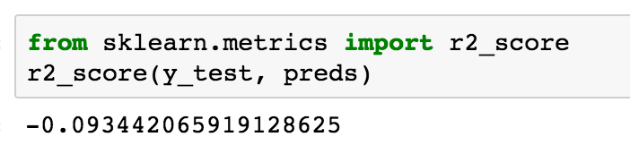
Results
R2 – score = -0.09
Over fitted model

